Slide 1
Processes and operating systems
Telephone answering machine.

Slide 2
Theory of operation
Compress audio using adaptive differential pulse code modulation (ADPCM).
analog
time
ADPCM
3
2
1
-1
-2
-3
time

Slide 3
ADPCM coding
Coded in a small alphabet with positive and negative values.
  {-3,-2,-1,1,2,3}
Minimize error between predicted value and actual signal value.

Slide 4
ADPCM compression system
Σ
quantizer
inverse
quantizer
integrator
encoder
samples
inverse
quantizer
integrator
decoder

Slide 5
Telephone system terms
Subscriber line: line to phone.
Central office: telephone switching system.
Off-hook: phone active.
On-hook: phone inactive.

Slide 6
Real and simulated subscriber line
Real subscriber line:
  90V RMS ringing signal;
  companded analog signals;
  lightning protection, etc.
Simulated subscriber line:
  microphone input;
  speaker output;
  switches for ring, off-hook, etc.

Slide 7
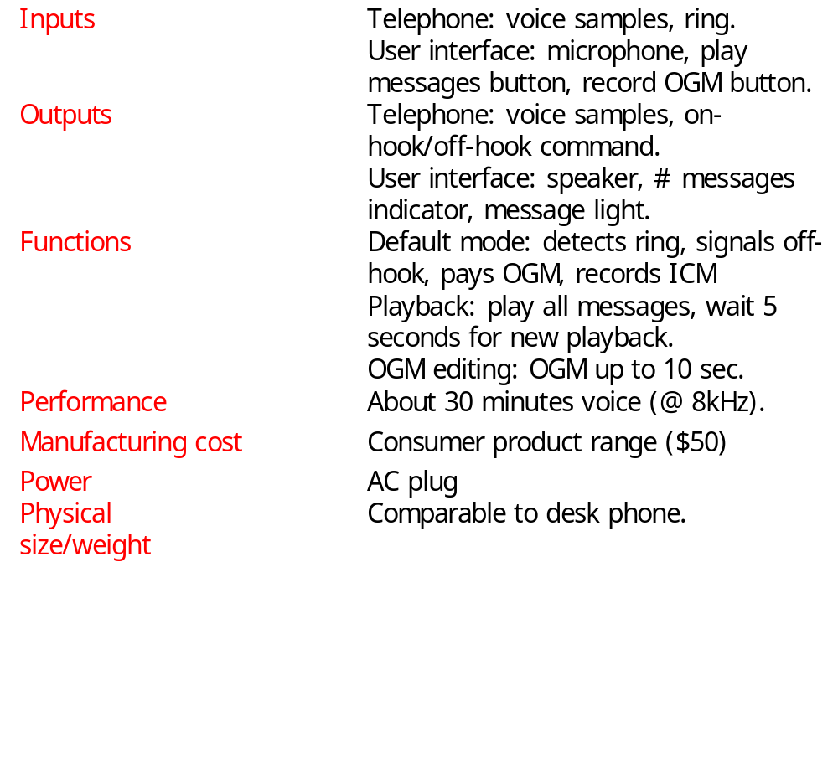
Requirements

Slide 8
Comments on analysis
DRAM requirement influenced by DRAM price.
Details of user interface protocol could be tested on a PC-based prototype.

Slide 9
Answering machine class diagram
1
1
1
Microphone*
1
Controls
Record
*
Outgoing-
message
1
1
1
1
1
1
Line-in*
*
1
*
1
1
Playback
Incoming-
message
Line-out*
*
1
1
Lights
Buttons*
1
Speaker*
1

Slide 10
Physical interface classes
Microphone*
Line-in*
Line-out*
sample()
sample()
ring-indicator()
sample()
pick-up()
Buttons*
Lights*
Speaker*
record-OGM
play
messages
num-messages
sample()

Slide 11
Message classes
Message
length
start-adrs
next-msg
samples
Incoming-message
Outgoing-message
msg-time
length=30 sec

Slide 12
Operational classes
Controls
Record
Playback
operate()
record-msg()
playback-msg()

Slide 13
Software components
Front panel module.
Speaker module.
Telephone line module.
Telephone input and output modules.
Compression module.
Decompression module.

Slide 14
Controls activate behavior
Compute buttons, line activations
Activations?
Play OGM
Record OGM
Play ICM
Erase
Answer
Play OGM
Wait for timeout
Allocate ICM
Erase
Record ICM

Slide 15
Record-msg/playback-msg behaviors
nextadrs = 0
nextadrs = 0
msg.samples[nextadrs] =
sample(source)
speaker.samples() =
msg.samples[nextadrs];
nextadrs++
F
F
End(source)
nextadrs=msg.length
T
T
record-msg
playback-msg

Slide 16
Hardware platform
CPU.
Memory.
Front panel.
2 A/Ds:
  subscriber line, microphone.
2 D/A:
  subscriber line, speaker.

Slide 17
Component design and testing
Must test performance as well as testing.
  Compression time shouldn’t dominate other tasks.
Test for error conditions:
  memory overflow;
  try to delete empty message set, etc.

Slide 18
System integration and testing
Can test partial integration on host platform; full testing requires integration on target platform.
Simulate phone line for tests:
  it’s legal;
  easier to produce test conditions.

